Slide 1



Blinkit
Sales Data Analysis
India's Last Minute App

Slide 2
Blinkit Sales Data Analysis
Name: Arpan Bhattacharya
College Name: Guru Nanak Institute Of Technology
Department : Information Technology
Semester : 7th
Internship Under: Classroom Tech
Phone: 8981838547 Website: https://classroomtech.in LinkedIn: https://www.linkedin.com/company/classroom-tech/ Duration: 1st April 2025 - 30th June 2025

Slide 3
Acknowledgement
I would like to express my heartfelt gratitude to Classroom for providing me with this valuable internship opportunity.
I am especially thankful to Satyaki Das for his constant support, feedback, and guidance throughout the project.
Lastly, I am grateful to my peers and teammates who contributed to discussions and enriched my understanding.

Slide 4
Introduction
Blinkit, formerly known as Grofers, is a leading online grocery delivery service in India. Founded in 2013, it has revolutionized the way people shop for groceries by offering a wide range of products delivered to their doorstep within minutes. With a user-friendly app and website,

Slide 5
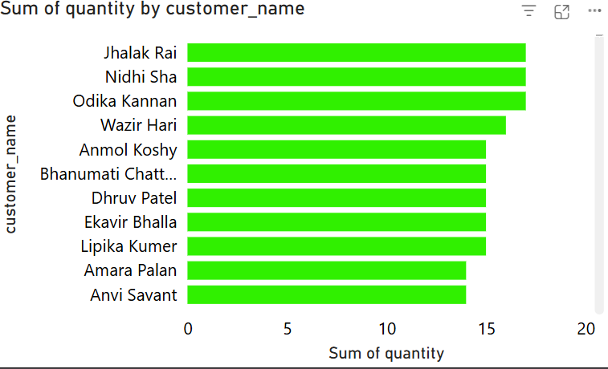
Visualization: Top Customers by Purchase Quantity
Insights
Jhalak Rai leads in total quantity purchased, closely followed by Nidhi Sha and Odika Kannan.
All top 10 customers have purchased similar quantities, suggesting consistent buyer behavior.
This data can be used to target high-volume customers for loyalty programs.
Purpose: To identify the customers who have purchased the highest quantity of products.

Slide 6
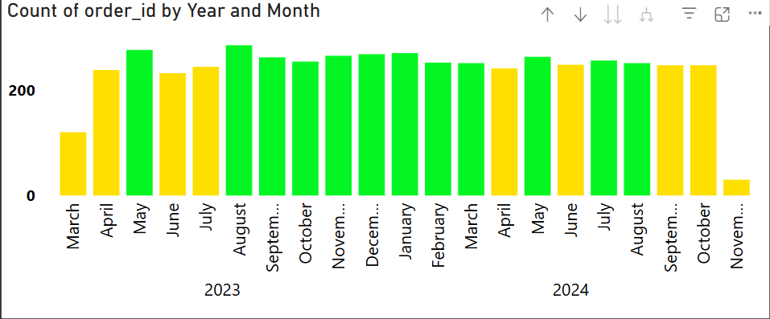
Visualization: Monthly Order Volume (2023–2024)
Insights
Order volume peaked in August 2023 and remained stable through December.
There was a noticeable dip in November 2024, possibly due to seasonal or operational factors.
Consistent monthly order activity suggests healthy business performance across two years.
Purpose: To analyze trends in the number of orders received over time.

Slide 7
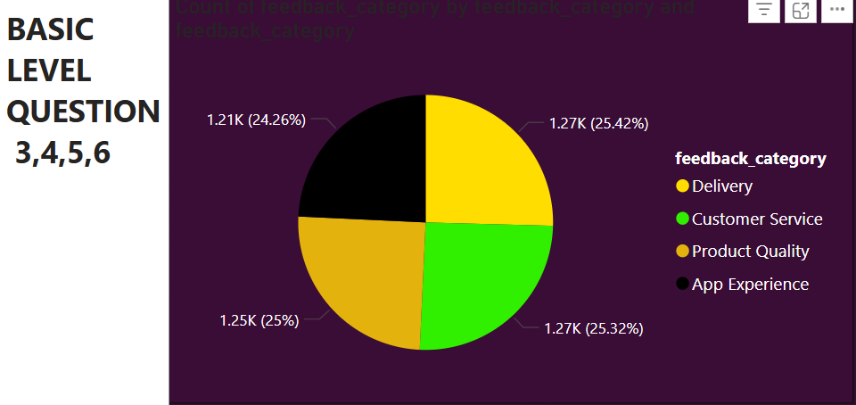
Visualization: Customer Feedback by Category
Insights
Feedback is evenly distributed across four main categories, with Delivery receiving the most (25.42%).
Customer Service and Product Quality also have a significant share of feedback, indicating areas of focus.
No single category dominates the feedback, highlighting the need for improvement across multiple aspects.
Purpose: To understand the areas in which customers are providing feedback.

Slide 8
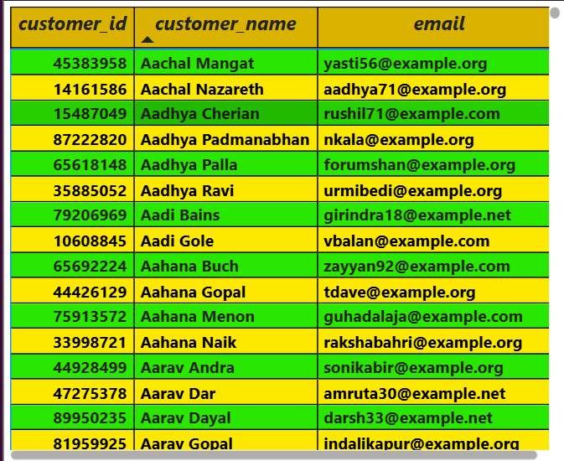
Visualization: Customer Directory with Email Contacts
Insights
The table provides a quick reference for reaching out to specific customers.
Highlights the breadth of unique customers, useful for segmentation or outreach.
Enables quick filtering of customers by name or email for targeted support or campaigns.
Purpose: To maintain a structured directory of customers and their contact details for communication and marketing.

Slide 9
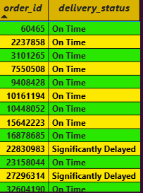
Visualization: Delivery Status by Order
Insights
Majority of orders are marked “On Time,” indicating reliable logistics.
A few orders show “Significantly Delayed” status, which can indicate operational bottlenecks.
Identifying delayed orders helps improve future service quality and customer satisfaction.
Purpose: To monitor the delivery performance of individual orders.

Slide 10
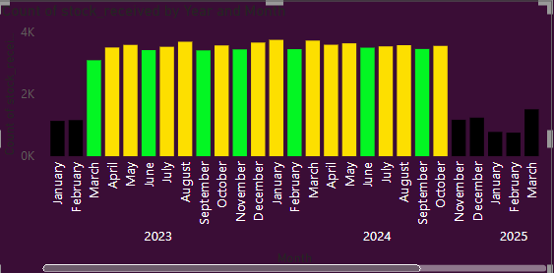
Visualization: Monthly Stock Received
Insights
Peak stock receipts occurred between April and September 2023.
There is a noticeable drop in stock receipts during late 2024 and early 2025.
Helps assess supply chain consistency and seasonal restocking trends.
Purpose: To analyze the trend of stock received across months and years.

Slide 11
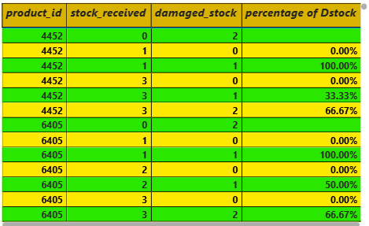
Visualization: Damaged Stock Ratio per Product
Insights
Some product entries (e.g., product_id 4452 and 6405) show up to 100% damage in certain batches.
A few batches have 0% damage, indicating batch or vendor variability.
These metrics help identify products or suppliers that may require quality control checks.
Purpose: To measure product quality issues through damaged stock reporting.

Slide 12
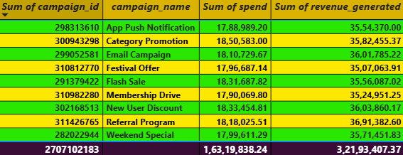
Visualization: Campaign-wise Spend vs Revenue
Insights
Referral Program” and “Weekend Special” generated the highest revenue (~36M and ~37M respectively).
All campaigns have a positive ROI, showing strong marketing impact.
Insights can guide future budget allocation to high-performing campaigns.
Purpose: To evaluate the effectiveness of different marketing campaigns.

Slide 13
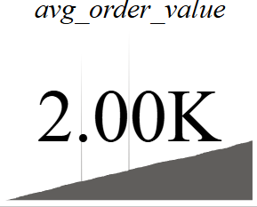
Visualization: Average Order Value (KPI Card)
Insights
An average order value of ₹2000 indicates a healthy transaction size.
This metric helps identify pricing strategies and bundling opportunities.
If combined with product-category analysis, can help increase AOV through upselling.
Purpose: To display the average monetary value of each order across all transactions.

Slide 14
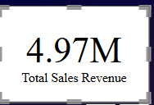
Visualization: Total Revenue from All Campaigns
Insights
The cumulative revenue is 4.97 million, showcasing a successful overall campaign performance.
Can be used as a benchmark for future targets.
Purpose: To display the total revenue generated from all sales or marketing campaigns.
.

Slide 15
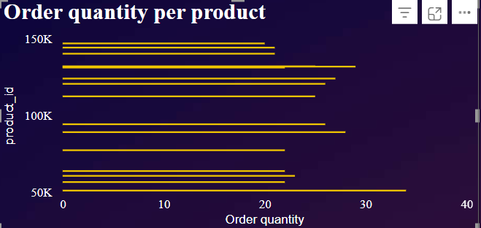
Visualization: Product-wise Order Quantity
Insights
Products like 992178 and 991443 have the highest order quantities.
A few products show relatively low order numbers, indicating low demand or visibility.
Purpose: To compare how many times each product was ordered.

Slide 16
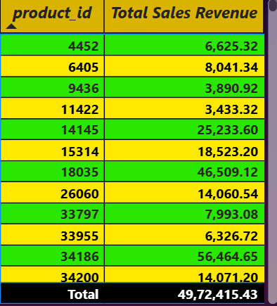
Visualization: Sales Revenue by Product
Insights
Product 51036 alone generated over 65K in revenue.
Top 5 products contribute a significant portion of overall revenue, indicating their importance in inventory decisions.
Purpose: To calculate and display revenue generated by individual products.

Slide 17
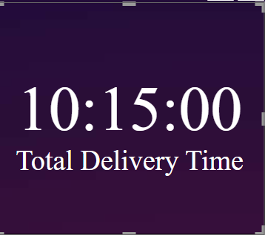
Visualization: Total Delivery Time(Card)
Insights
Total delivery time logged is 10 hours and 15 minutes.
Useful in analyzing efficiency and identifying time delays in logistics.
Purpose: To calculate the cumulative delivery time using actual_time -promised_time.
.

Slide 18
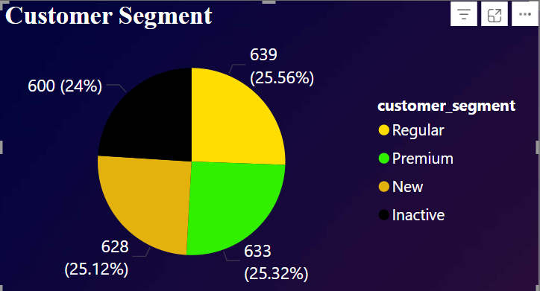
Visualization: Customer Segment Distribution
Insights
Segments are fairly balanced: Regular (25.56%), Inactive (24%),Premium(25.32%), New(25.12%).
The Premium segment is almost equal in size to Regular and New.
Helps in tailoring marketing strategies for each group.
Purpose: To visualize how customers are segmented based on behavior or purchase history.

Slide 19
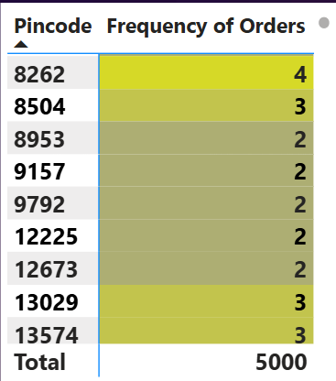
Visualization: Pincode Heatmap
Insights
Pincode 1489 has the highest number of orders (5).
Most pincodes have 2-3 orders indicating distributed demand.
Helps target areas with higher engagement for local promotions.
Purpose: To analyze which locations (pincodes) have the most customer orders.

Slide 20
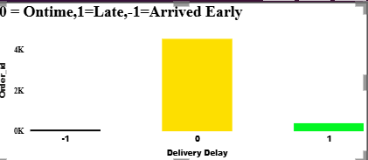
Visualization: Delivery Delay Analysis
Insights
Majority of deliveries are on time
A small fraction arrived early, while late deliveries are rare.
Demonstrates strong operational efficiency.
Purpose: To visualize and categorize orders based on their delivery status: 0 = On Time, 1 = Late, -1 = Arrived Early.

Slide 21
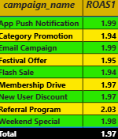
Visualization: Campaign ROAS Comparison
Insights
Referral Program has the highest ROAS (2.03), indicating great efficiency.
Most campaigns have ROAS around 1.95-2.00, reflecting consistent performance.
Can be used to optimize budget allocation in future campaigns.
Purpose: To measure and compare the Return on Ad Spend across multiple marketing campaigns.

Slide 22
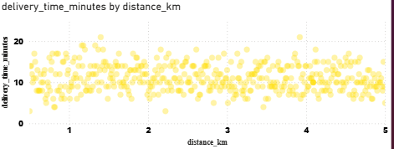
Visualization: Delivery Efficiency Analysis (Scatter Plot)
Insights
No strong correlation: delivery time fluctuates regardless of distance.
Indicates other factors (traffic, time of day, logistics) may influence delivery time more than distance.
Useful for performance optimization
Purpose: To analyze the relationship between delivery distance and delivery time.

Slide 23
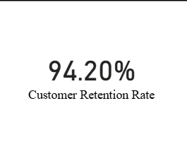
Visualization: Customer Retention Rate
Insights
Retention rate is 94.20%, indicating excellent customer loyalty.
Suggests successful user experience and repeat engagement.
Useful for projecting future revenue and customer lifetime value.
Purpose: To measure how many customers return to place another order.

Slide 24
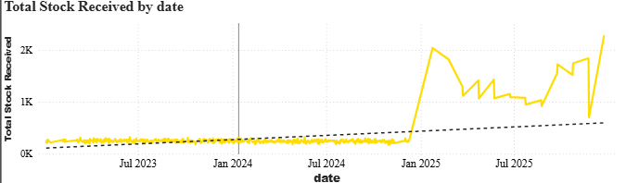
Visualization: Total Stock Received Over Time with Forecast
Insights
Stock received increases sharply from early 2025.
The dotted trendline suggests a continued upward movement in demand.
Important for procurement and warehouse planning.
Purpose: To forecast future stock needs using trends from past received stock data.

Slide 25
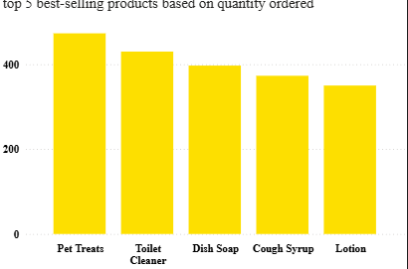
Visualization: Top 5 Best-Selling Products
Insights
Pet Treats and Toilet Cleaner are top sellers.
All top 5 products have over 350 units sold.
Indicates where inventory priority and promotions should focus.
Purpose: To identify the most frequently ordered products.

Slide 26
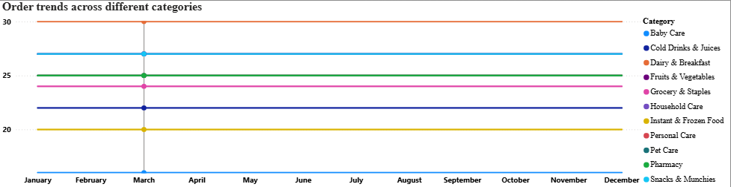
Visualization: Order Trends Across Different Categories
Insights
Baby Care consistently has the highest order volume (~30 orders monthly).
Pharmacy and Instant & Frozen Food see relatively lower order volumes.
Trends remain stable over the year— suggesting consistent customer preference.
Purpose: To analyze how different product categories perform over the months.

Slide 27
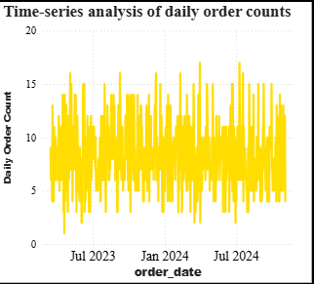
Visualization: Time-Series Order Analysis
Insights
Orders remain steady, with minor peaks and troughs.
Some short-term spikes might align with campaigns or holidays
No major long-term increase/decrease—indicates market stability.
Purpose: To observe daily order volume fluctuations and trends over 2023-2024.

Slide 28
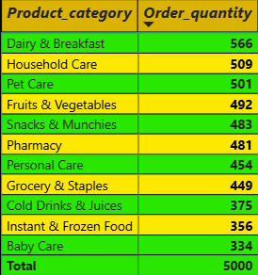
Visualization: Product Category vs Order Quantity
Insights
Dairy & Breakfast leads with 566 units, followed by Household Care and Pet Care.
Lower quantities in Baby Care and Cold Drinks indicate seasonal or niche demand.
Ideal for inventory planning and j category-specific promotions.
Purpose: To display which categories have the highest cumulative product orders.

Slide 29
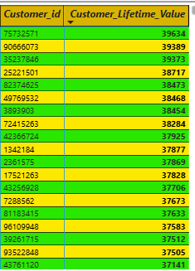
Visualization: Customer Lifetime Value
Insights
Top customers show lifetime values over 39,000, with a longterm revenue potential.
LTV distribution helps segment premium vs casual buyers.
Crucial for targeted loyalty campaigns.
Purpose: To calculate lifetime value based on avg_order_value X total orders.

Slide 30
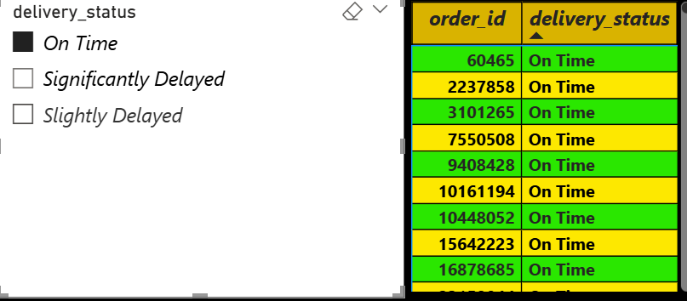
Visualization: Filter Orders by Delivery Status(Using Slicer)
Insights
Interactive slicer allows quick filtering by delivery status.
Current view shows all selected orders as On Time.
Great tool for real-time logistics performance tracking.
Purpose: To dynamically filter and display orders based on delivery performance (On Time, Slightly Delayed, Significantly Delayed).

Slide 31
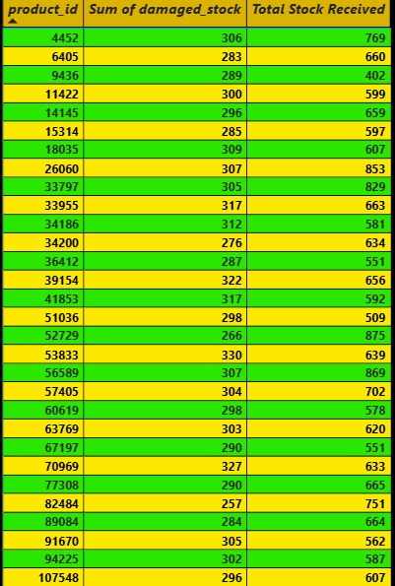
Visualization: Merged Stock Report
Insights
Products like 6405 and 9436 have damage counts over 280 units.
Total Stock Received ranges between 400 and 900 per product.
Useful for identifying suppliers or SKUs with consistent quality issues.
Purpose: To analyze and compare total received stock and damaged stock per product.

Slide 32
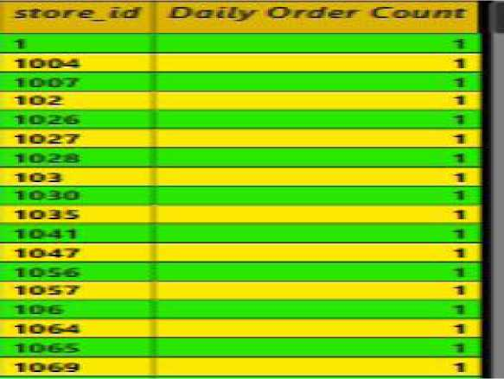
Visualization : Daily Order Count by Store
Insights
All listed stores have exactly 1 order the dataset (current filtered view).
Total of 3,470 orders processed— shows high store engagement.
Ideal for evaluating store-wise order fulfillment performance.
Purpose: To track the number of orders processed per store location.

Slide 33
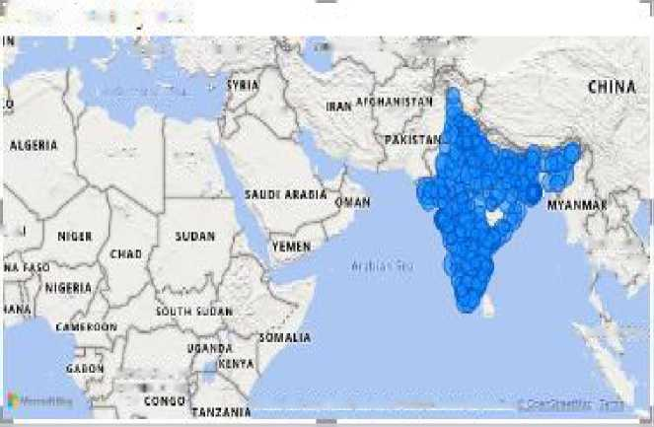
Visualization : Geographic Order Distribution
Insights
High order density in metro cities and Tier-1 zones.
North and South India show more coverage than the Northeast.
Supports regional expansion and logistics resource allocation.
Purpose: To visualize which regions place the most orders.

Slide 34
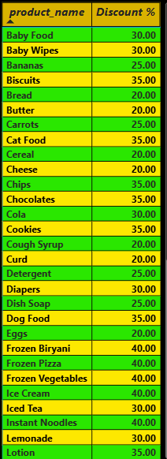
Visualization : Product-wise Discount Percentage
Insights
Products like Chocolates, Cookies, and Chips offer up to 35% discount.
Majority of items fall in the 20%-30% discount range.
Useful for identifying top-discounted products to promote.
Purpose: To show the calculated discount percentages by comparing Price and MRP.

Slide 35
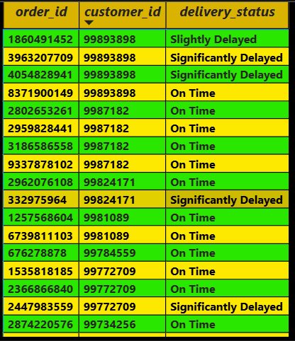
Visualization : Live Order Delivery Status
Insights
Most deliveries are On Time, with a few marked as Slightly Delayed.
Helps customer service teams monitor exceptions in real time.
Useful for immediate operational decision-making.
Purpose: To track the live status of orders and delivery outcomes.

Slide 36
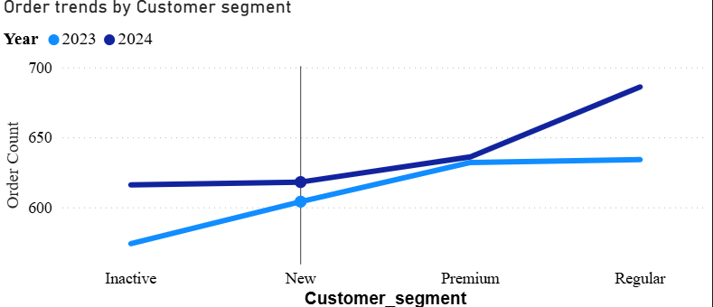
Visualization : Order Trends by Customer Segment (Drill-down)
Insights
Regular and Premium customers show an upward order trend into 2024.
Inactive segment shows a flat trend, indicating limited re-engagement
Drill-down can further reveal trends by
Purpose: To analyze how order volume trends across segments (Inactive,
New, Premium, Regular) over time.

Slide 37
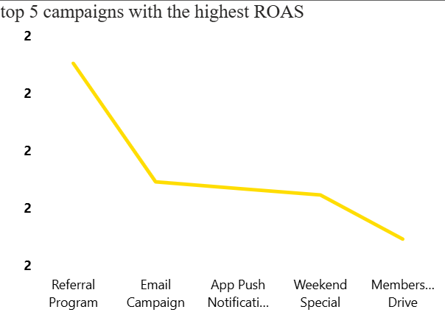
Visualization : Top 5 ROAS-Performing Campaigns
Insights
Referral Program delivers the best return.
Campaigns like Member Drive underperform in comparison.
Can inform future ad budget prioritization.
Purpose: To identify the most efficient marketing campaigns using ROAS metric.

Slide 38
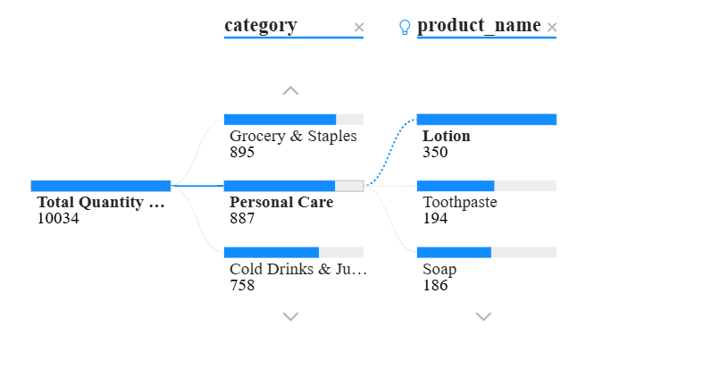
Visualization : Decomposition of Product Sales by Category
Insights
Pharmacy and Pet Care are top categories based on quantity sold.
Within Personal Care, items like Toothpaste and Soap perform well.
Great for multi-level drill-down analysis and exploring sales hierarchies.
Purpose: To visually break down total sales into category-wise and product-wise contributions.

Slide 39
Key Findings
1. Customer retention is high at 94.20%, with Regular and Premium segments placing the most orders.
2. Pet Treats is both the best-selling and highest-margin product.
3. The Referral Program delivers the highest ROAS among all campaigns.
4. Most deliveries are on time, but some products show recurring damaged stock.
5. Sales trends, order heatmaps, and store-level data support smarter regional planning.

Slide 40
Conclusion
Through this analysis, I learned how to use Power BI to clean data, build interactive dashboards, and extract meaningful business insights. It helped me understand customer behavior, sales trends, and campaign performance using real-world datasets. This project also strengthened my skills in data visualization, DAX, and report storytelling. The insights generated can guide decision-makers in optimizing product offerings, improving delivery efficiency, and allocating marketing budgets more effectively. Overall, this analysis supports data-driven strategies to enhance customer satisfaction and business growth.

Slide 41
References
Dataset Source: [Kaggle - Blinkit Sales Dataset]
Visualization Tool: Microsoft Power BI
Report Hosting: GitHub (Your project repository link)
Internship Platform: Classroom Tech
Official LinkedIn: Classroom Tech -https://www.linkedin.com/company/classroom-tech/

Slide 42
GitHub Repository Link
Link: https://github.com/arpan-10-4/Blinkit-Sales-Data-Analysis

Slide 43
Thank You!
Name : Arpan Bhattacharya
Email : arpanbhattacharya124@gmail.com LinkedIn : https://www.linkedin.com/in/arpan-bhattacharya-a880b528b/

